Slide 1
Video Milestone Tracking
For Adobe Analytics
By Alexis Cazes

Slide 2
Requirements!!!
The video player does not matter!
Checks for both website and app implementation:
The Adobe Analytics is implemented successfully and data is displayed in Adobe Analytics !
The video reporting is configured correctly in Adobe Analytics V14 !
The Media module is implemented successfully with the right settings!
The Media module methods are called in the right order and at the right time!
Notes:
It does not matter which player and video implementation one can use on their website or mobile app. As long as :
They have configured the video reporting in Adobe Analytics V14 correctly.
They have implemented the correct Adobe Analytics library and they can send image request to our servers successfully and the data is displayed correctly.
They have implemented the media module correctly (with the right settings).
They are calling the correct media module methods at the right time

Slide 3
Check Adobe Analytics implementation
First Step

Slide 4
Is Adobe Analytics implemented successfully on website or APP ?
Without a successful Adobe Analytics implementation there is no way Adobe milestone video tracking will work
Check that successful image request are sent to Adobe servers using a packet monitor
Check that data is present in Adobe Analytics
If all good then you can proceed to next step!
Notes:
Packet monitor documentation : https://marketing.adobe.com/resources/help/en_US/sc/implement/packet_monitor.html

Slide 5
If not correct
Troubleshoot your implementation
For website implementation start from the beginning.
For mobile implementation follow the first steps for SDK 4.x :
IOS SDK 4.x : https://marketing.adobe.com/resources/help/en_US/mobile/ios/dev_qs.html
ANDROID SDK 4.x: https://marketing.adobe.com/resources/help/en_US/mobile/android/dev_qs.html

Slide 6
Configure Adobe Analytics Video Reports
USE ADOBE ANALYTICS V14
Second step

Slide 7
Video configuration in Adobe Analytics
You MUST!!!! log in Adobe Analytics v14 to configure the Video Settings
You need to choose:
3 eVars with full subrelation enabled
7 events
1 prop with pathing enabled
You can also specify additional events and variables to be displayed under Video reporting
If you decide to use Ad video tracking additional variables will need to be used
Notes:
The 3 eVars are :
Video name with default expiration visit
Segments with default expiration pageview
Content Type with default expiration pageview
The 7 events are all counter events :
Video time
Video Views
Video Completes
Video Segment Views
25% viewed
50% viewed
75% viewed
The prop needs to be pathing enabled, it will capture the video name as well
If you decide to use Ad video tracking additional variables will need to be used
Documentation can be found here : https://marketing.adobe.com/resources/help/en_US/sc/appmeasurement/video/video_config.html

Slide 8
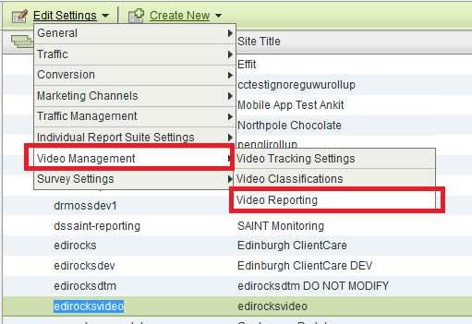
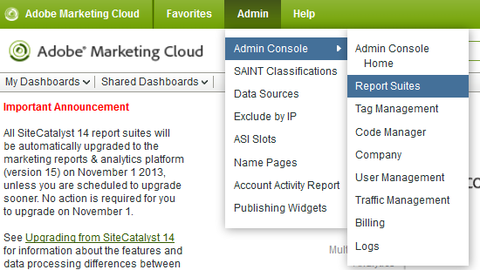
Access the video reporting settings
Notes:
1.Connect to Adobe Analytics v14
2.Go to Admin >> Admin Consoles >> report suites
3.Select Report suite
4.Click on Edit settings >> Video Management >> Video Reporting

Slide 9
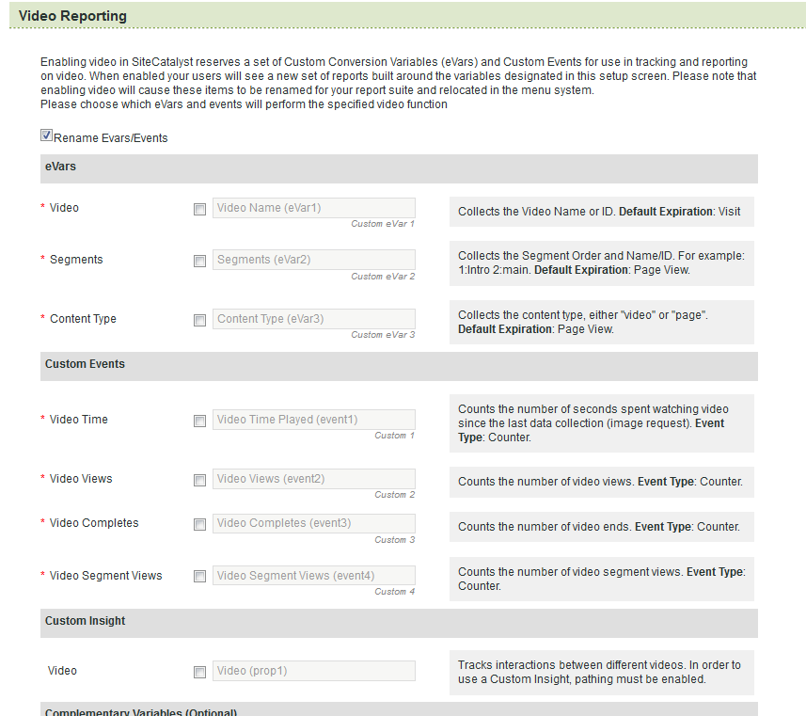
Notes:
All fields with a red * needs to be specified

Slide 10
Create processing rules for mobile video tracking
If not done data will be sent to Adobe Analytics but not data will be displayed

Slide 11
Create processing rules.
To create processing rules in Adobe Analytics, you need to be enabled
You need to pass an exam : https://marketing.adobe.com/resources/help/kb/en_US/analytics/kb/processing-rules-authorization.html
If you use Adobe Mobile Services then you need to be an admin to make the mapping under custom data content : https://marketing.adobe.com/resources/help/en_US/mobile/settings_custom_data.html
The rules will be used to map the media mobile variables sent to the video reporting variables defined in SC14.

Slide 12
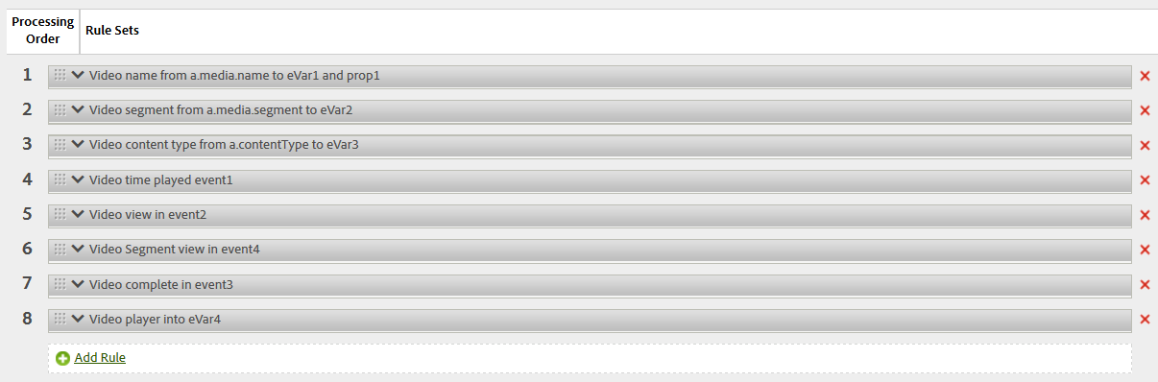
Processing rules examples

Slide 13
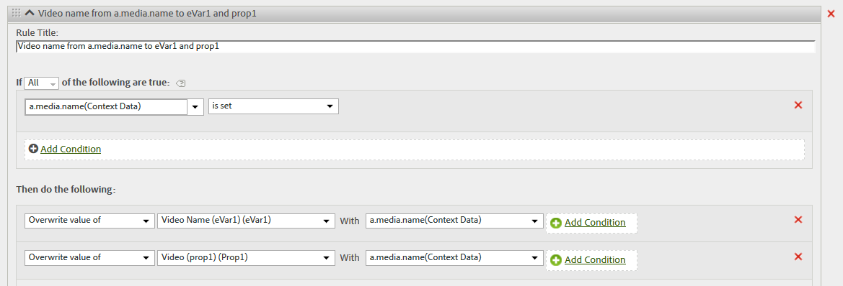
Video name

Slide 14
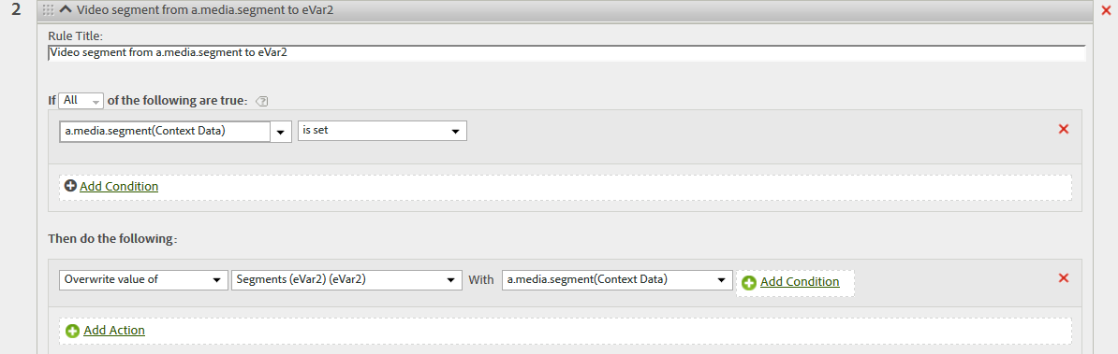
Video Segment

Slide 15
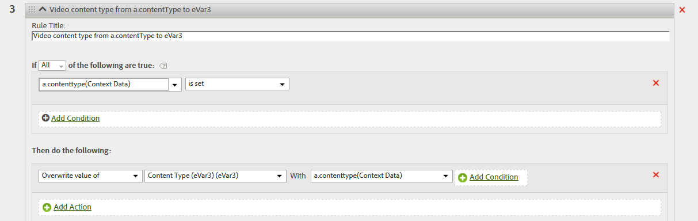
Video Content Type

Slide 16
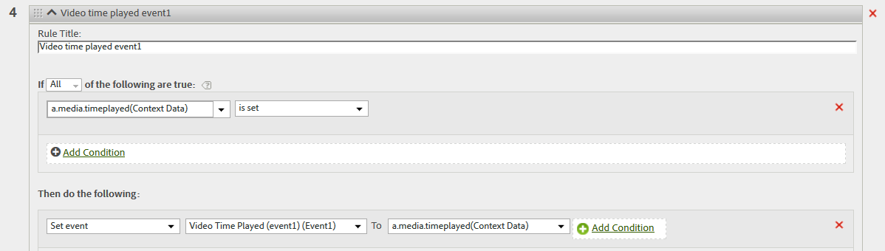
Video time played

Slide 17
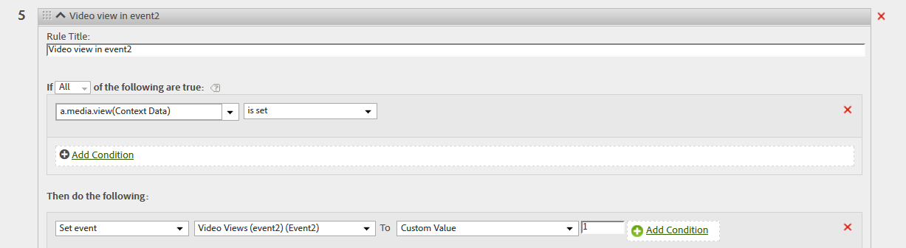
Video view

Slide 18
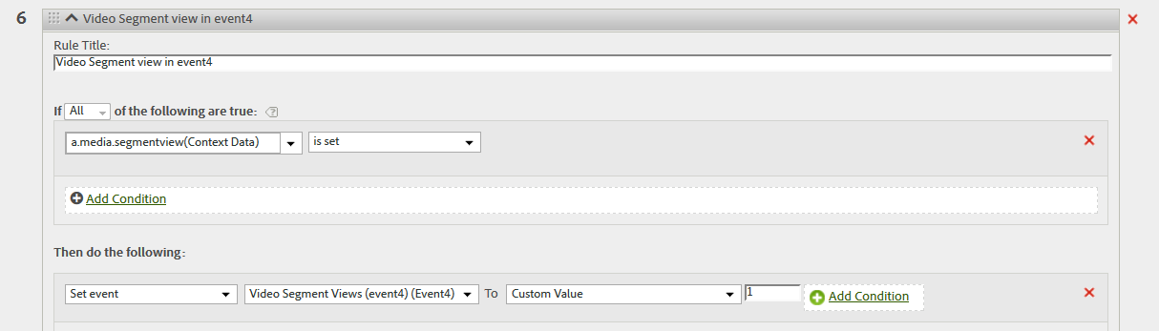
Video Segment view

Slide 19
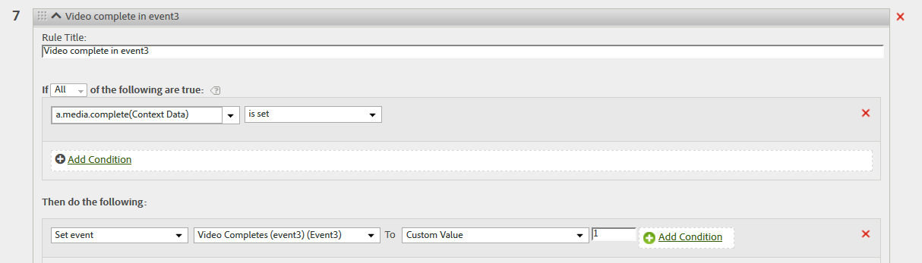
Video complete

Slide 20
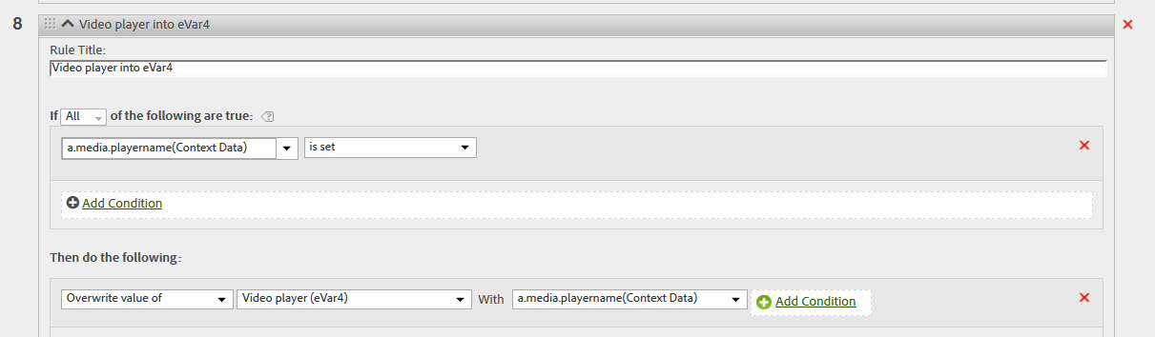
Video player

Slide 21
Video milestones

Slide 22
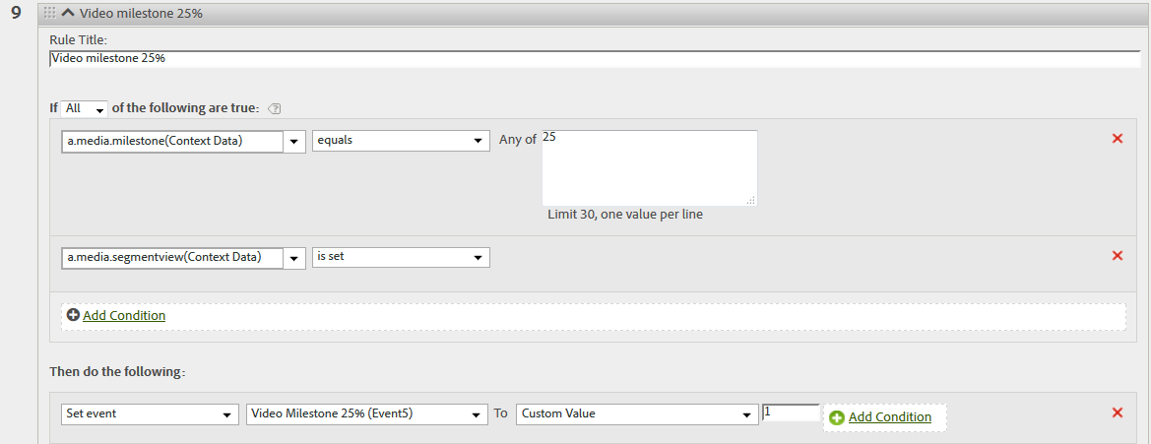
Video milestone 25%

Slide 23
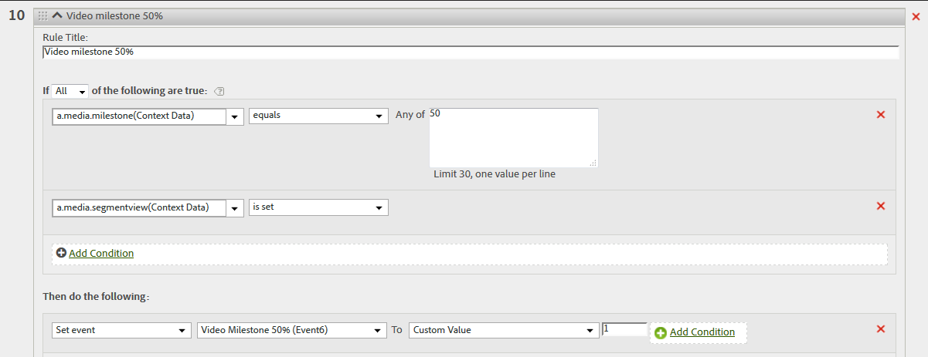
Video milestone 50%

Slide 24
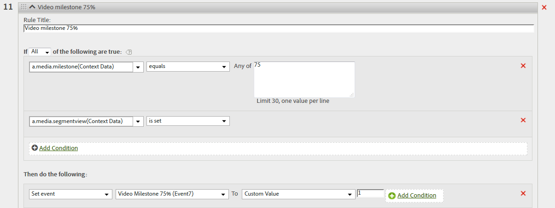
Video milestone 75%

Slide 25
Configure the Media module
Third Step

Slide 26
Choose the right tracking library for your video player

Slide 27
Different Video Players available
Flash
HTML5
Hybrid Flash + HTML5
Mobile APP : ANDROID, IOS […]
Other : Silverlight, Windows Media, QuickTime
Partner players
Paid providers : Brightcove, Ooyala, Kaltura, The platform
Open source: JW Player, FlowPlayer
Free providers : Youtube, Vimeo, Facebook
Custom: Home Built Players
If you can implement an HTML5 player and a Flash player, then you should be able to implement any other.
Notes:
These are the different Video players that you would come across :
Flash
HTML5
Hybrid Flash + HTML5
Mobile APP
Other : Silverlight, Windows Media, QuickTime
Partner players
Paid providers : Brightcove, Ooyala, Kaltura, The platform
Open source: JW Player, FlowPlayer
Free providers : Youtube, Vimeo, Facebook
Custom: Home Built Players
If you can implement an HTML5 player and a flash player, then you should be able to implement any other.

Slide 28
How to identify a video player
Ask you client
Right click on the video ➔ if Flash you should get details for Flash
Look at the source code
If it is an app ➔see mobile APP implementation documentation
IOS SDK 4.x : https://marketing.adobe.com/resources/help/en_US/mobile/ios/video_qs.html
ANDROID SDK 4.x : https://marketing.adobe.com/resources/help/en_US/mobile/android/video_qs.html
WINDOWS SDK 4.x : https://marketing.adobe.com/resources/help/en_US/mobile/winu/video_qs.html
Notes:
All documentations for mobile can be found here : https://marketing.adobe.com/resources/help/en_US/reference/developer.html

Slide 29
AutoTrack vs Manual Tag:
What is the difference between autoTrack and a manual tag?
Our code has to be told when:
the video is beginning
it has ended
someone pause/or resumed it
it has paused to buffer/resumed play
the user has skipped ahead/back
This is handled by the video player's event handlers
AutoTrack is when our code "already knows" which event listeners to listen for
Manual tag is when the client's developers have to tell us when those things happen

Slide 30
Decide on AutoTrack or Manual Tag - when to use manual tag
The player is not supported by autoTrack
Classifying a videoID to a friendly name isn't a viable option
Live streams (video with no defined end)
Client wants to use custom segment names
AutoTrack Refuses to work

Slide 31
Media Module settings
Mobile vs. Web

Slide 32
Mobile Media module settings
IOS SDK 4.x | ANDROID SDK 4.x

Slide 33
IOS SDK 4.x
All details provided in the IOS SDK 4.x doc
First you need to call :
ADBMediaSettings *mediaSettings = [ADBMobile mediaCreateSettingsWithName:MEDIA_NAME length:MEDIA_LENGTH playerName:PLAYER_NAME playerID:PLAYER_ID];
Once you called the above, choose if you want to track the standard milestone which correspond to percentage:
mediaSettings.milestones = @"25,50,75"; mediaSettings.segmentByMilestones = YES;
Notes:
IOS SDK 4.x doc: https://marketing.adobe.com/resources/help/en_US/mobile/ios/video_qs.html

Slide 34
IOS SDK 4.x
Or you want to track offset milestone which correspond to specific seconds that elapsed since the video started to play:
mediaSettings.offsetMilestones = @"60,120"; mediaSettings.segmentByOffsetMilestones = YES;
If you want a hit to be sent every X seconds then implement the following:
mediaSettings.trackSeconds = 30; // sends a hit every 30 seconds
THIS IS ALL THE MEDIA MODULE CONFIGURATION THAT IS NEEDED. YOU CAN MIX AND MATCH THE OPTIONS BUT THEY NEED TO BE PRESENT BEFORE THE NEXT STEP.

Slide 35
ADNROID SDK 4.x
All details provided in ANDROID SDK 4.x doc
First you need to call :
MediaSettings settings =Media.settingsWith(MEDIA_NAME, MEDIA_LENGTH, PLAYER_NAME, PLAYER_ID);
Once you called the above, choose if you want to track the standard milestone which correspond to percentage:
settings.milestones = "25,50,75"; settings.segmentByMilestones = true;
Notes:
ANDROID SDK 4.x doc : https://marketing.adobe.com/resources/help/en_US/mobile/android/video_qs.html

Slide 36
ANDROID SDK 4.x
Or you want to track offset milestone which correspond to specific seconds that elapsed since the video started to play:
settings.offsetMilestones = "60,120"; settings.segmentByOffsetMilestones = true;
If you want a hit to be sent every X seconds then implement the following:
settings.trackSeconds = 30; // sends a hit every 30 seconds
THIS IS ALL THE MEDIA MODULE CONFIGURATION THAT IS NEEDED. YOU CAN MIX AND MATCH THE OPTIONS BUT THEY NEED TO BE PRESENT BEFORE THE NEXT STEP.

Slide 37
Web Media module implementation
JavaScript | Flash

Slide 38
Download the media module
Go to Admin ➔ Code manager
AppMeasurement JavaScript: in the zip file downloaded you should see “AppMeasurement_Module_Media.js” ➔ copy to AppMeasurement.js.
Legacy JavaScript code (H version): should be present in the s_code.js file
For Flash add the corresponding library as present in the zip folder.
Notes:
All the code libraries should contain the media module code.

Slide 39
Media module implementation
For JavaScript implementation place the Media module code above the line DO NOT ALTER BELOW THIS LINE either in the s_code.js file of AppMeasurement.js file.
Initialise the Media module : s.loadModule("Media")

Slide 40
Video code implementation
All code versions video milestone implementation is described here: https://marketing.adobe.com/resources/help/en_US/sc/appmeasurement/video/video_developer.html
In each case you will have to create the variable mapping file.
For manual tracking you will have to input your code in the functions ran when an event happens like play, pause, stop, complete

Slide 41
Variable mapping
s.Media.autoTrack= true; ➔ set to true when using AutoTrack. In most of the case set to false for manual tracking
s.Media.trackVars="events,prop2,eVar1,eVar2,eVar3";
s.Media.trackEvents="event1,event2,event3,event4,event5,event6,event7“
➔All variables set in video reporting in Adobe Analytics v14 should be listed in these 2 variables
s.Media.trackMilestones="25,50,75"; ➔ declare which milestone you want to track

Slide 42
Variable mapping
s.Media.playerName="My Media Player"; ➔ name of the player, not tracked by default in any report but can be tracked using processing rules
s.Media.segmentByMilestones = true; ➔ Tells if when milestone met send image request or not
s.Media.trackUsingContextData = true; ➔always set to true
s.Media.contextDataMapping = { […] } ➔Map all the variables declared in Video reporting settings

Slide 43
Variable mapping: s.Media.contextDataMapping
a.media.name":"eVar2,prop2",
"a.media.segment":"eVar3",
"a.contentType":"eVar1",
"a.media.timePlayed":"event3",
"a.media.view":"event1",
"a.media.segmentView":"event2",
"a.media.complete":"event7",
"a.media.milestones":{
25:"event4",
50:"event5",
75:"event6"
}
The eVars, props and events should match exactly what is in Video Reporting Settings.
Only the additional eVars and events for additional reporting will not be declared in this code. They will be declared in Media.monitor

Slide 44
No variable mapping
Processing rules will be required to map data to correct reports.

Slide 45
No variable mapping
If you omit a variable to be mapped in s.Media.contextDataMapping then this variable will be present in the image request in c. a.[variable name].
The variables in the image request will be contextData variables using the Adobe reserved variable a.
Processing rules will be required to map these variables to the video reports
The variables will be identical to the one sent in the mobile video SDK 4.x video implementation ➔ referrer to slide 10 to 24 for example of processing rules

Slide 46
Example content type : correct mapping code
s.Media.contextDataMapping = {
"a.media.name":"eVar1,prop1",
"a.media.segment":"eVar2",
"a.contentType":"eVar3",
"a.media.timePlayed":"event1",
"a.media.view":"event2",
"a.media.segmentView":"event4",
"a.media.complete":"event3",
"a.media.milestones":{
25:"event5",
50:"event6",
75:"event7"
}
}

Slide 47
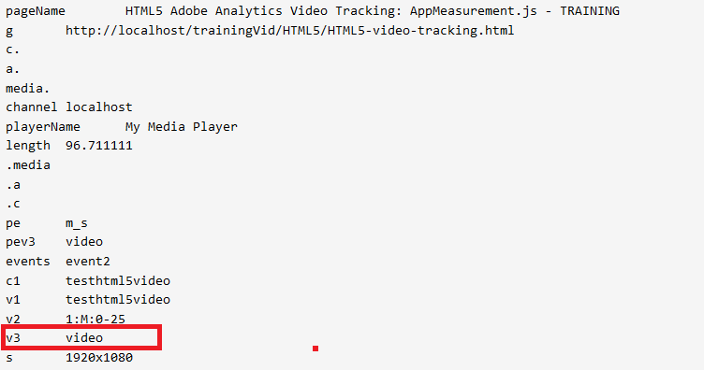
Example content type : correct mapping image request

Slide 48
Example content type : NO mapping code
s.Media.contextDataMapping = {
"a.media.name":"eVar1,prop1",
"a.media.segment":"eVar2",
"a.media.timePlayed":"event1",
"a.media.view":"event2",
"a.media.segmentView":"event4",
"a.media.complete":"event3",
"a.media.milestones":{
25:"event5",
50:"event6",
75:"event7"
}
}

Slide 49
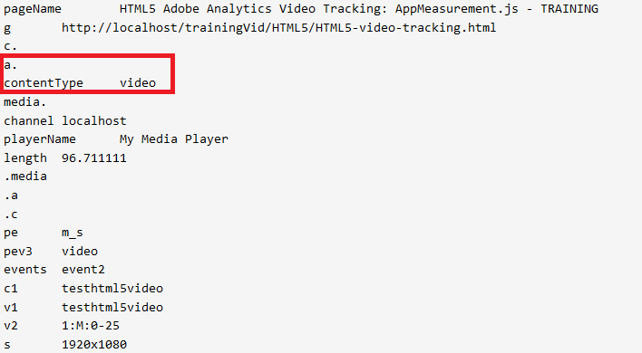
Example content type : NO mapping image request

Slide 50
Send Media data to Adobe Analytics
Media module methods Best Practice
LAST step

Slide 51
Order in which you need to call Media methods
MEDIA OPEN
Video Start
MEDIA PLAY
Video is playing
MEDIA STOP
Video is stopped
MEDIA CLOSE
Video is completed
Notes:
When the Video is opened for the first time, Media open will be called followed by Media play.
Every single time the video is played, the Media play needs to be called. Make sure to specify the correct offset
Every single time the video is stopped, the Media stop needs to be called. Make sure to specify the correct offset.
Once the video is completed, call Media stop followed by Media Close.
Media open and Media close will send an image request.
Media play and Media stop do not send an image request by default ➔ use Media Monitor is you want to send additional data.

Slide 52
Manual tagging – Video function to call
Function to call | When to call it | How often to call per Video view | Send image request to Adobe Analytics
Media.open | Video Load/First Play | 1 | YES
Media.play | Any time the video begins to play, resume, buffer complete, scrub release, or segment change | As often as needed | NO
Media.stop | Any time the video stops, pauses, buffers, scrubber grab or segment change | As often as needed | NO
Media.close | Video Complete | 1 | YES
Notes:
Documentation for the functions can be found here: https://marketing.adobe.com/resources/help/en_US/sc/appmeasurement/video/video_ref_methods.html
If you are using ad tracking, it will have its own functions

Slide 53
Examples
Load: Call Media.open and Media.play
Pause: Call Media.stop. For example, if a user pauses a video after 15 seconds, call s.Media.stop("Video1",15)
Buffer: Call Media.stop while the video buffers. Call Media.play when playback resumes.
Resume: Call Media.play. For example, when a user resumes a video after initially playing 15 seconds of the video, call s.Media.play("Video1",15).
Scrub (slider): When the user drags the video slider, call Media.stop. When the user releases the video slider, call Media.play.
End: Call Media.stop, then Media.close. For example, at the end of a 100-second video, call s.Media.stop("Video1",100), then s.Media.close("Video1").
Notes:
From doc : https://marketing.adobe.com/resources/help/en_US/sc/appmeasurement/video/video_js_events.html

Slide 54
1.Open the Media Tracking
This should be followed by Media Play

Slide 55
IOS SDK 4.x Media Open
If all of the settings are set correctly then you can open the tracking for he Video.
Media open without callback:
[ADBMobile mediaOpenWithSettings:mediaSettings callback:nil];

Slide 56
IOS SDK 4.x Media Open With Callback
Media Open with callback (correspond to Media.monitor):
[ADBMobile mediaOpenWithSettings:settings callback:^(ADBMediaState *state) { NSLog(@"mediaEvent = %@", state.mediaEvent); if ([state.mediaEvent isEqualToString:@"PLAY"]) { [ADBMobile mediaTrack:MEDIA_NAME data:@{@"myKey":@"myVal"}]; } else if (state.milestone == 50) { [ADBMobile mediaTrack:MEDIA_NAME data:@{@"MyMilestone":@"50"}]; } }];
Notes:
For IOS SDK 4.x, Media Open with Callback will be used to specify custom tracking. This will correspond to Media Monitor

Slide 57
ANDROID SDK 4.x Media Open
Without callback: Media.open(settings, null);
With callback (correspond to Media.monitor):
Media.open(mySettings, new Media.MediaCallback(MediaState state) {
@Override
public void call(state) {
if(state.mediaEvent == OPEN){
//DO SOMETHING!
}
if(state.Milestone == 50){
//DO SOMETHING
}
}
});
Notes:
For ANDROID SDK 4.x, Media Open with Callback will be used to specify custom tracking. This will correspond to Media Monitor

Slide 58
JavaScript
Example of code :
s.Media.open(mediaName,mediaLength,mediaPlayerName);
Parameters:
mediaName: (required) The name of the video as you want it to appear in video reports.
mediaLength: (required) The length of the video in seconds.
mediaPlayerName: (required) The name of the media player used to view the video, as you want it to appear in video reports.

Slide 59
2.Media Play
Should be called as much as needed when the video is playing.

Slide 60
Media Play when the video is opened.
When the video is started the offset needs to be set to zero
IOS SDK 4.x :
[ADBMobile mediaPlay:MEDIA_NAME offset:0];
ANDROID SDK 4.x :
Media.play(MEDIA_NAME, 0);
Javascript :
s.Media.play(name,0);

Slide 61
Media Play any other time
The correct offset needs to be specified
IOS SDK 4.x :
[ADBMobile mediaPlay:MEDIA_NAME offset:mediaController.currentPlaybackTime];
ANRDOI SDK 4.x:
Media.play(MEDIA_NAME, mediaPlayer.getCurrentPosition());
JavaScript:
s.Media.play(name,offset);

Slide 62
3.Media Stop
Should be called as much as needed when the video is stopped

Slide 63
Media stop
IOS SDK 4.x :
[ADBMobile mediaStop:MEDIA_NAME offset:mediaController.currentPlaybackTime];
ANDROID SDK 4.x :
Media.stop(MEDIA_NAME, mediaPlayer.getCurrentPosition());
JavaScript :
s.Media.stop(mediaName,mediaOffset);

Slide 64
4.Media Close
Should be called when the video is completed just after Media stop

Slide 65
Media Close
IOS SDK 4.x :
[ADBMobile mediaStop:MEDIA_NAME offset:mediaController.currentPlaybackTime];
[ADBMobile mediaClose:MEDIA_NAME];
ANDROID SDK 4.x :
Media.stop(MEDIA_NAME, mediaPlayer.getCurrentPosition());
Media.close(MEDIA_NAME);
JavaScript:
s.Media.stop("testhtml5video",currentTime);
s.Media.close("testhtml5video");

Slide 66
Media monitor
Send additional video data

Slide 67
Media.monitor
You can define a custom Media.monitor method to track additional video metrics.
It should be placed in the same file as your Media module code (s_code.js or AppMeasurement.js)
Will be used with:
Media.trackVars
Media.trackEvents
Media.track
For mobile using Media Open with callback correspond to Media.monitor
Media track should be used.
Notes:
Documentation: https://marketing.adobe.com/resources/help/en_US/sc/appmeasurement/video/video_mediamonitor.html

Slide 68
Media variables
The following Media variables can be used to create a rich logic to send additional data to adobe analytics: JavaScript
media.mediaEvent
OPEN
CLOSE
PLAY
STOP
MONITOR
SECONDS
MILESTONE
media.name | media.offset
media.length | media.percent
media.playerName | media.timePlayed
media.mediaEvent | media.eventFirstTime
media.openTime

Slide 69
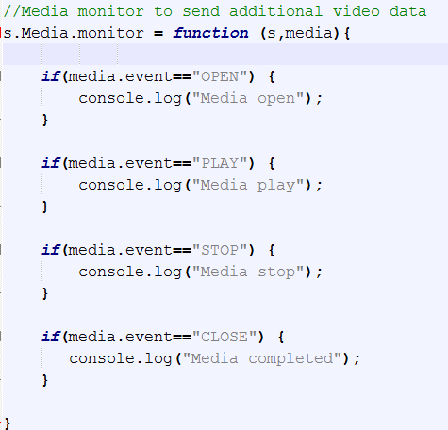

Slide 70
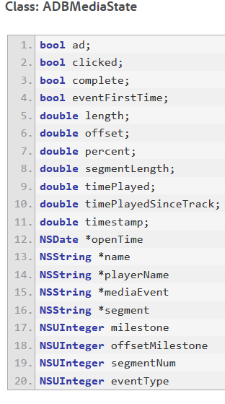
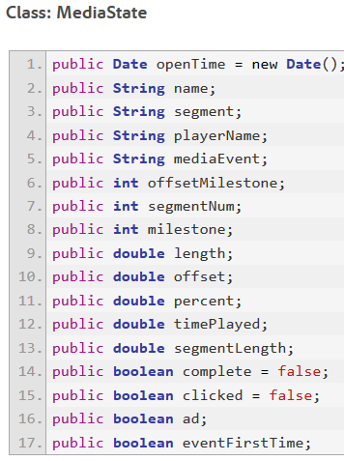
Mobile Media State
IOS SDK 4.x
ANDROID SDK 4.x

Slide 71
CHECK ADOBE ANALYTICS IMPLEMENTATION
Analytics code image request sent to Adobe servers
Data is displayed in Adobe Analytics
Configure Video Reporting in Adobe Analytics V14
Video reporting settings are done in Adobe Analytics V14 ONLY
All required fields are linked to a variable
Media module installed correctly
Media module settings are configured correctly
Media methods
All methods are called in the right order
Methods are called at the right time using event listeners
Using media monitor/callback to send additional data

Slide 72
Data Insertion API and Video Milestone

Slide 73
Data Insertion API
If you cannot use any of the default Adobe Analytics library to track Video Milestone, use Data Insertion API
Example: PS4 and XBOX ONE
Use the Adobe reserved variables for video in conjunction with processing rules
More information about data insertion API
Notes:
https://marketing.adobe.com/developer/documentation/data-insertion/c-data-insertion-api

Slide 74
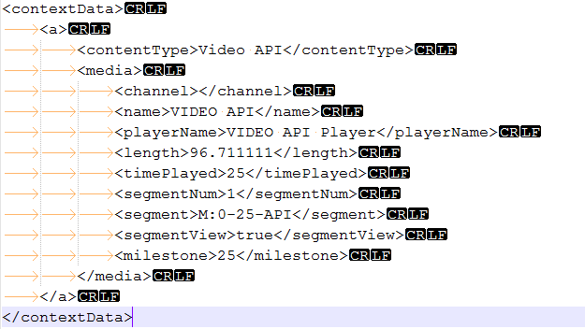
Code

Slide 75
Code examples
Alexis Cazes : https://github.com/alcazes/Adobe-Analytics-Video-tracking-s_code
https://github.com/alcazes/Adobe-Analytics-Milestone-VIdeo-AppMeasurement-JS
https://github.com/alcazes/Android-Milestone-Video-tracking
Brightcove flash implementation: https://github.com/alcazes/Adobe-Analytics-Video-tracking-s_code/tree/master/Brightcove-flash
HTML5 JavaScript: https://github.com/alcazes/Adobe-Analytics-Video-tracking-s_code/tree/master/HTML5
https://github.com/alcazes/Adobe-Analytics-Milestone-VIdeo-AppMeasurement-JS/tree/master/HTML5
Youtube iframe: https://github.com/alcazes/Adobe-Analytics-Video-tracking-s_code/tree/master/Youtube-iframe
https://github.com/alcazes/Adobe-Analytics-Milestone-VIdeo-AppMeasurement-JS/tree/master/Youtube-iframe

Slide 76
Additional documentation
Milestone video tracking: https://marketing.adobe.com/resources/help/en_US/sc/appmeasurement/video/
Internal videos and documentation: https://wiki.corp.adobe.com/pages/viewpage.action?spaceKey=ACS&title=Video
Marijka Engel Adobe Blogs: http://blogs.adobe.com/digitalmarketing/author/marijka-engel/
IOS SDK 4.x Video: https://marketing.adobe.com/resources/help/en_US/mobile/ios/video_qs.html
ANDROID SDK 4.x Video: https://marketing.adobe.com/resources/help/en_US/mobile/android/video_qs.html

Slide 77
Mobile code example
ANDROID SDK 4.x:
https://github.com/alcazes/mobile-services/blob/master/samples/Android/ADBMobileSamples/src/com/adobe/adbmobilesamples/MediaActivity.java
https://github.com/alcazes/mobile-services/blob/master/samples/Android/ADBMobileSamples/src/com/adobe/adbmobilesamples/VideoPlayerActivity.java
IOS SDK 4.x:
https://gist.github.com/hunterpeterson/9121178
https://github.com/alcazes/mobile-services/blob/master/samples/iOS/ADBMobileSamples/ADBMobileSamples/MediaViewController.m

Slide 78
QUESTIONS
Thanks for your attention

